Slide 1

Club PETANQUE
Our mission is to facilitate connections between
FENCH SAVOIR VIVRE AND PHILIPPINES

Slide 2

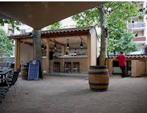
COOP
PHILIPPINES
FRANCE
FEDERATION
PHILIPPINES PETANQUE
Join us for a COOP ACTIVITY
CLUB PETANQUE MAMATID
A CONVIVIAL PLACE TO REST WITH FRIENDS
AMENAGE A DOUBLE PISTES TO PLAY AT LEAST
A LIMITED INVEST TO START

Slide 3
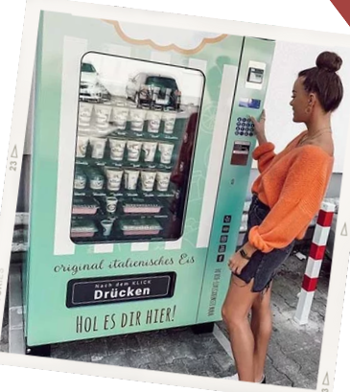

COOP
PHILIPPINES
FRANCE
FEDERATION
PHILIPPINES PETANQUE
Join us for a BUSINESS ACTIVITY
CLUB PETANQUE MAMATID
A BAR AND BISTRO FOR MEMBERS
WITH DRINKS. SANDWICHS AND LOCAL FOOD

Slide 4
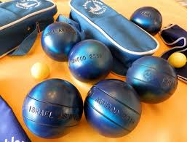
COOP
PHILIPPINES
FRANCE
FEDERATION
PHILIPPINES PETANQUE
Join us for a GAME
CLUB BLUES PETANQUE MAMATID
FROM 7-77 YEARS OLD
WOMEN AND MEN
OCCASIONALS OR MEMBERS
ENTERTAINMENT SINGLE OR TEAM
RENT OR SELL BOULES

Slide 5

COOP
PHILIPPINES
FRANCE
FEDERATION
PHILIPPINES PETANQUE
Join us for a REGIONAL, NATIONAL OR INTERNATIONAL COMPETITION
PARTICIPE TO THE “D…… CHALLENGE”
AND INSTALL A
…..
MINI SHOP/RELAY WITH DISTRIBUTEUR FRANCE
MACHINE FOR “BOULES”

Slide 6



COOP PHILIPPINES FRANCE
Contact US
(+63) 956 309 8584 / (+63) 969 196 0782
info@philippinesfrance.com
http://www.philippinesfrance.com

