Slide 1

CATALOG - CATALOGUE
Services and products
FRANCE PHILIPPINES
AND
PHILIPPINES FRANCE
French Touch to the Philippines
CATALOG PHILIPPINES and FRANCE GROUPI M P O R T E X P O R T
Our mission is to facilitate connections between French SME-SMI companies seeking to establish or expand their presence in the Asia Pacific region

Slide 2

FRANCE PHILIPPINES
PHILIPPINES FRANCE
Equipments : Ipsum Tek Robot, Filtralife Water, Distributeur France, Digby for Wine, Robot Coupe, Fourneaux Lacanche, Parinox, Yokler Triporteur, Ligier Utilitaires
Products : Bioteos (Oxylon) Aliplus Food, Corsica Cheese, Boulangerie Groupe Blachere
Services : Ad Creative, Augmented Reality, Soil Injection, Franchise HAMy, Franchise Bistro Bakery, Leon
Social-activity : Mission Coop, Petanque Club, Visit France

Slide 3
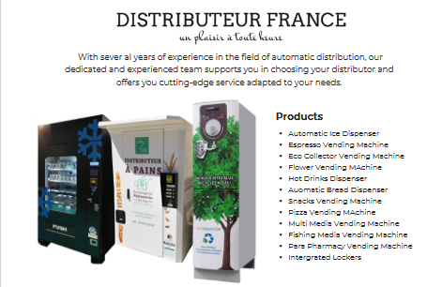
COOP
FRANCE PHILIPPINES
COOP
PHILIPPINES FRANCE
All distribution devices to your measurements

Slide 4


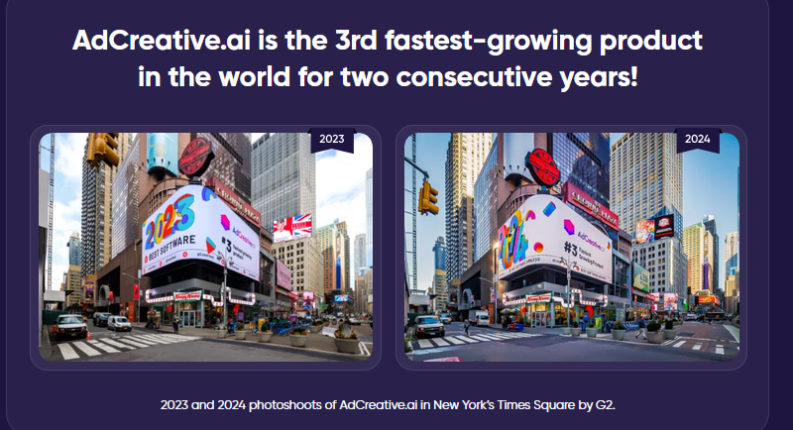
FRANCE PHILIPPINES
PHILIPPINES FRANCE

Slide 5
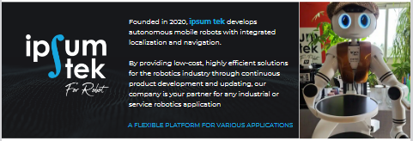
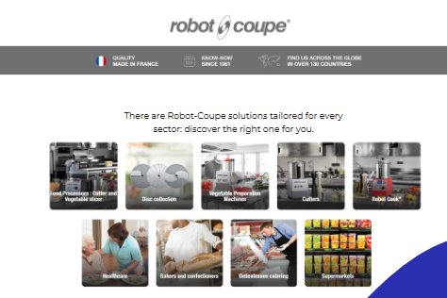
FRANCE PHILIPPINES
PHILIPPINES FRANCE
Robot for hotels, restaurants and events
All utensils
for Kitchen

Slide 6

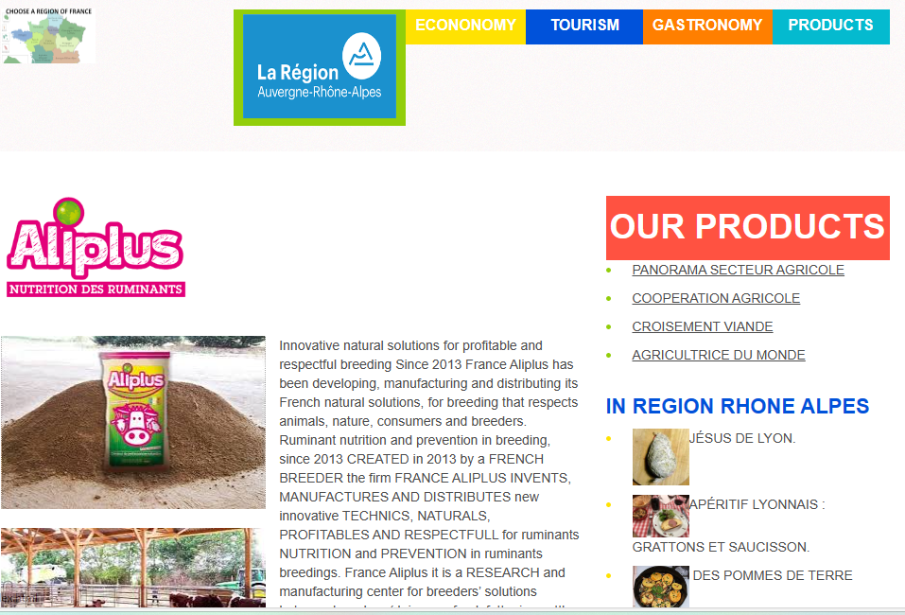

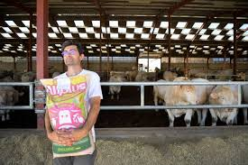
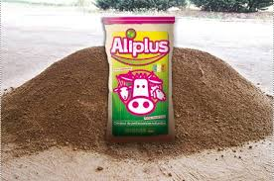
FRANCE PHILIPPINES
PHILIPPINES FRANCE
Innovative natural solutions
for profitable and respectful breeding

Slide 7
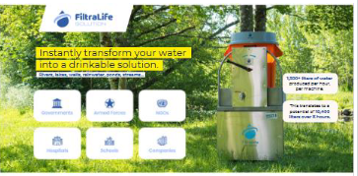

FRANCE PHILIPPINES
PHILIPPINES FRANCE
Water good to drink everywhere you want !
New !
Best Augmented Reality for marketing!

Slide 8
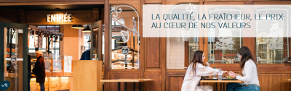
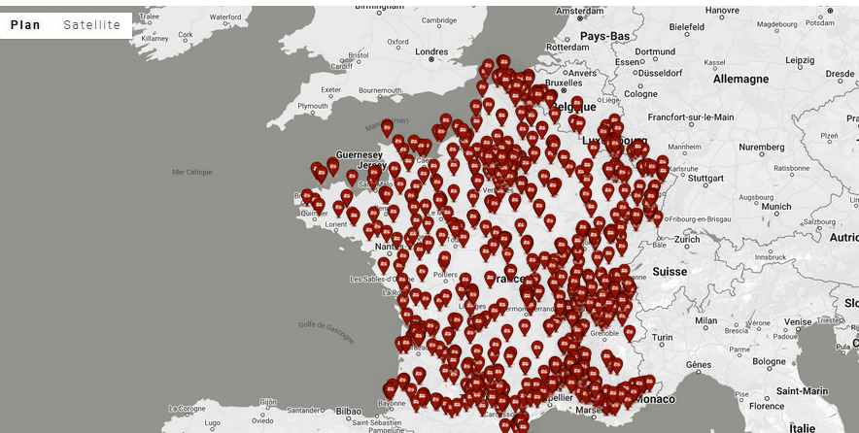
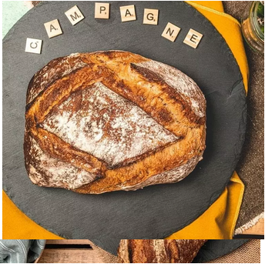
FRANCE PHILIPPINES
PHILIPPINES FRANCE
Franchise
Cafe Boulangerie
Groupe
Blachere
Be in Philippines
Like more
than 783
Boulangers
in France

Slide 9
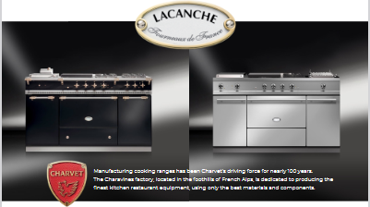
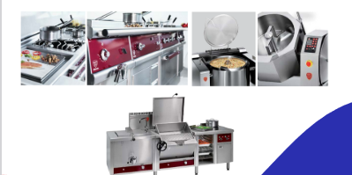
FRANCE PHILIPPINES
PHILIPPINES FRANCE
BEST “FRENCH TOUCH FOURNEAUX”

Slide 10
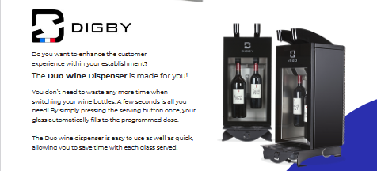
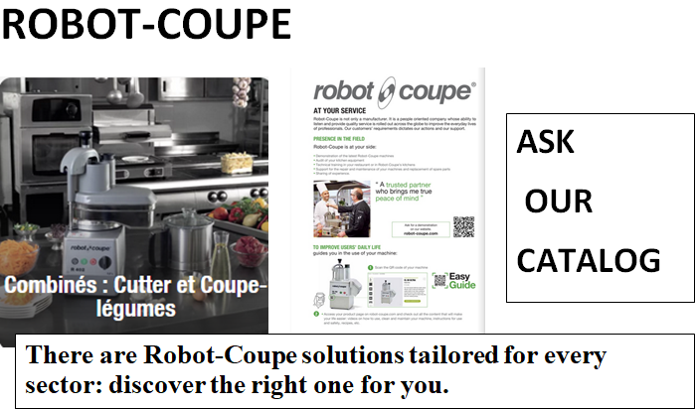
FRANCE PHILIPPINES
PHILIPPINES FRANCE
Just a glass of wine !
Use the best for cooking !

Slide 11
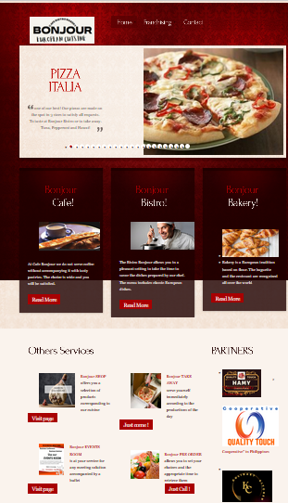
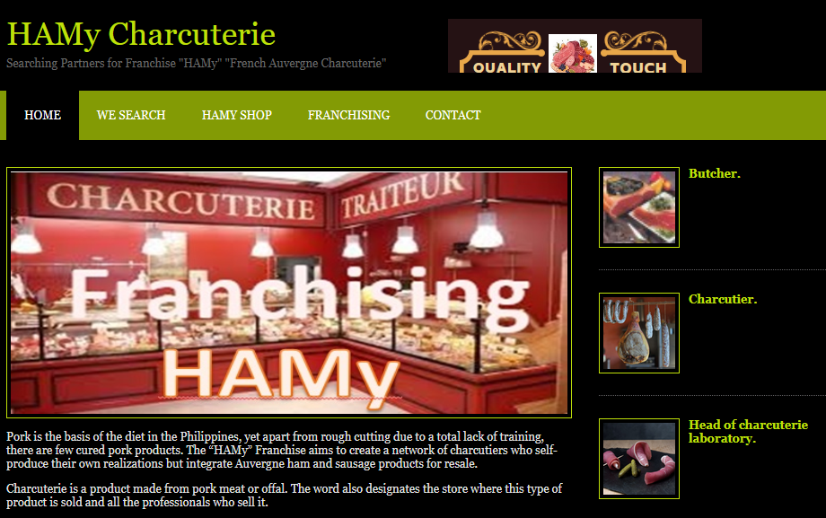
COOP
FRANCE PHILIPPINES
COOP
PHILIPPINES FRANCE
European Cuisine
Charcuterie
We develop “Franchise”!

Slide 12

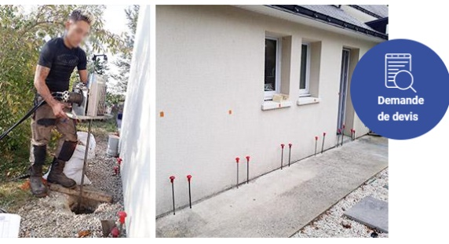
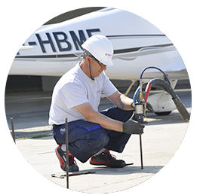
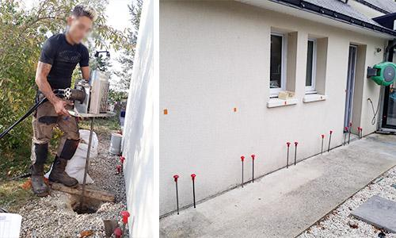
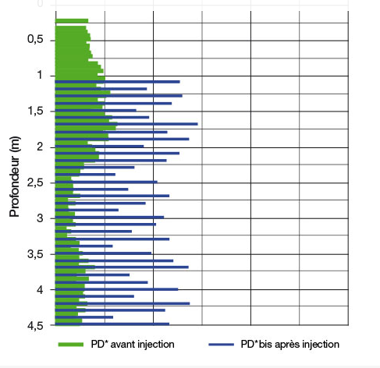
COOP
FRANCE PHILIPPINES
COOP
PHILIPPINES FRANCE
A building and/or paving settles when its base is made of particularly compressible materials.
It could be a soil with insufficient initial bearing capacity such as embankments. It can also be an accidental weakened ground, for example following a water leak in the ground or an accidental decompression after uncontrolled earthmoving nearby. The settlement of the ground causes that of the construction above. SOLINJECTION® techniques allow the consolidation of these soils with insufficient bearing capacity

Slide 13
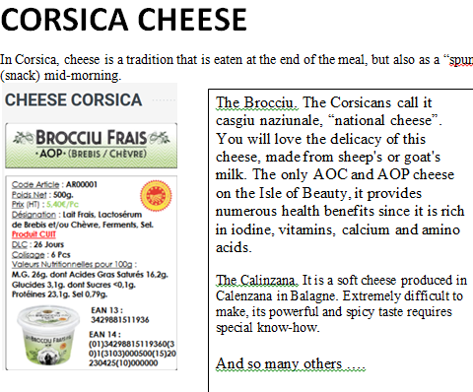
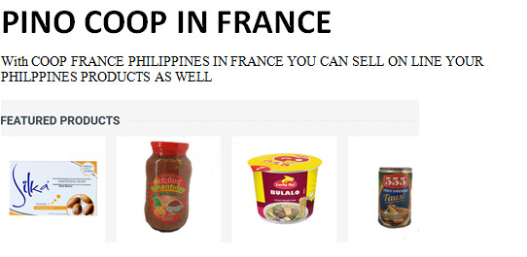
FRANCE PHILIPPINES
PHILIPPINES FRANCE
Taste a regional cheese
From Corsica !
We sell Philippines products in France !

Slide 14
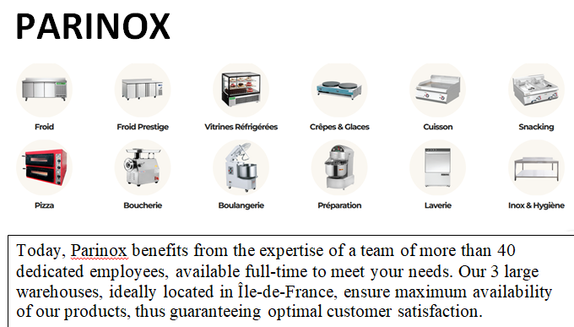
FRANCE PHILIPPINES
PHILIPPINES FRANCE
Large range for Chief !

Slide 15
FRANCE PHILIPPINES
PHILIPPINES FRANCE
Large range for Chief !

Slide 16

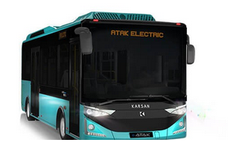
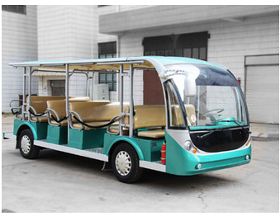
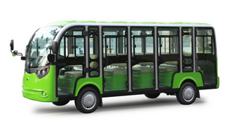
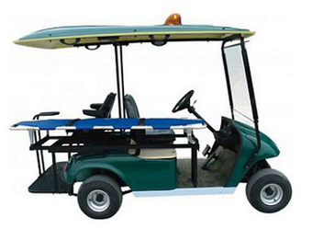
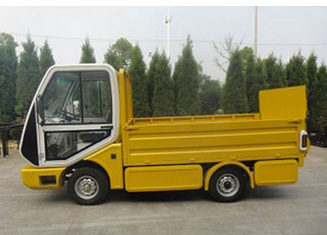
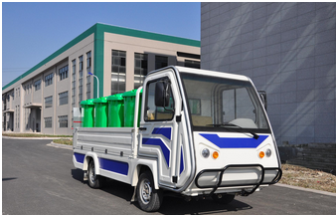
FRANCE PHILIPPINES
PHILIPPINES FRANCE
LIGIER : French Electric Utilitary Leader

Slide 17
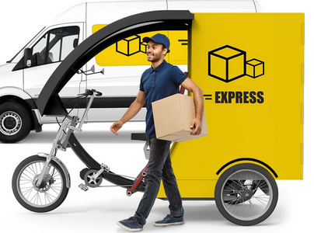
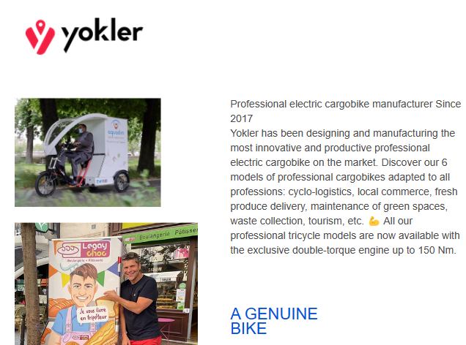
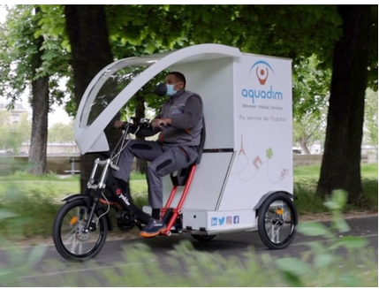
FRANCE PHILIPPINES
PHILIPPINES FRANCE
French Professional electric cargobike manufacturer!

Slide 18
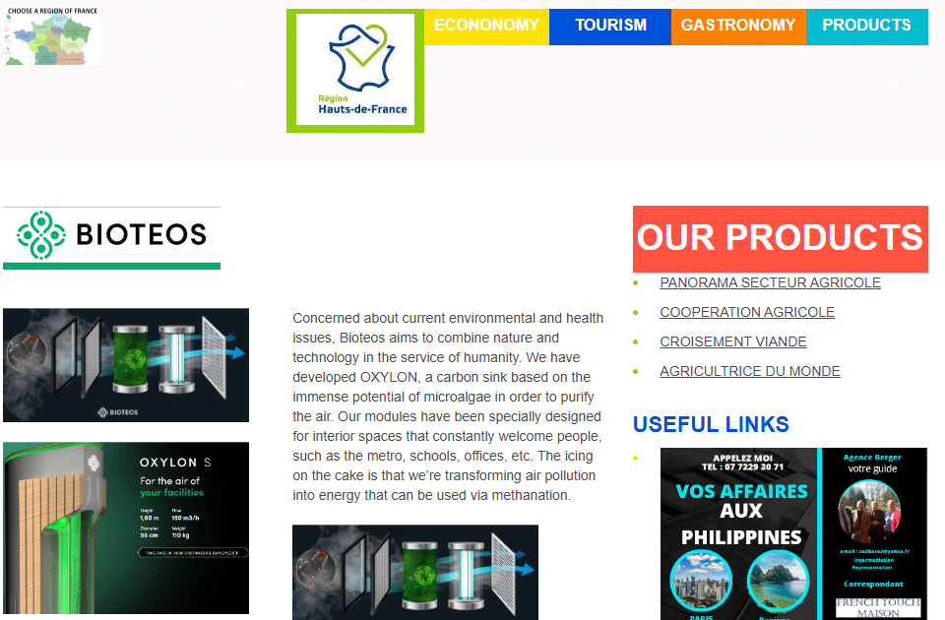
FRANCE PHILIPPINES
PHILIPPINES FRANCE
BIOTEOS : OXYLON
We decided to combine Nature & Technology to design OXYLON: a functional urban furniture improving the air quality of interior spaces welcoming the public as well as 30 trees would. How? ‘Or’ What ? Thanks to the great properties of microalgae.

Slide 19
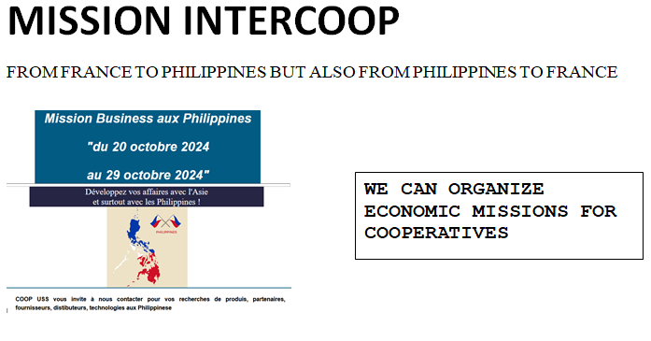
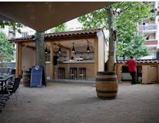
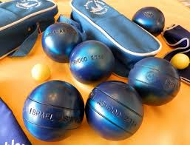
FRANCE PHILIPPINES
PHILIPPINES FRANCE
Meet The GROUP !
Join us for
a
PETANQUE GROUP CLUB

Slide 20
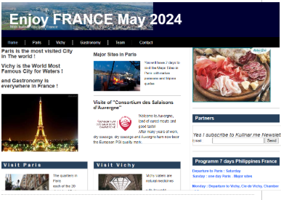
FRANCE PHILIPPINES
PHILIPPINES FRANCE
VISIT FRANCE PARIS VICHY
WITH PHILIPPINES AND FRENCH GROUP TEAM

Slide 21

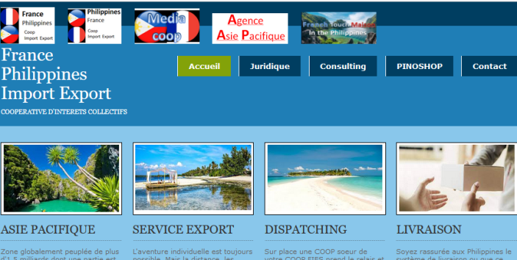
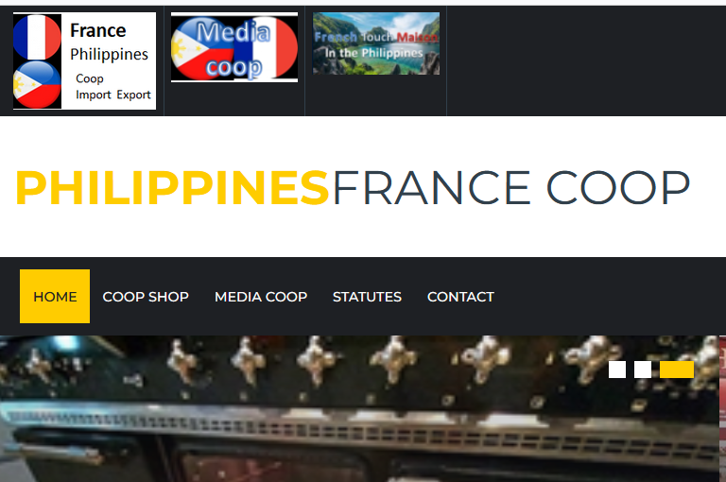
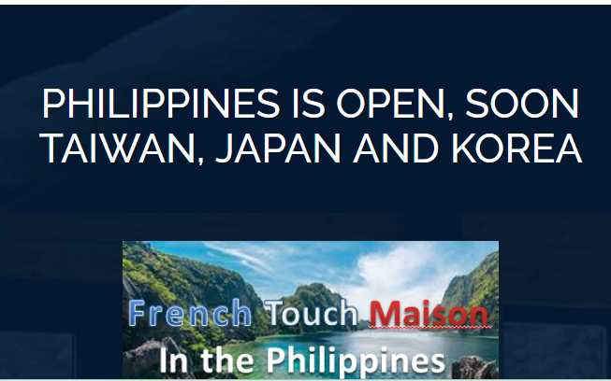

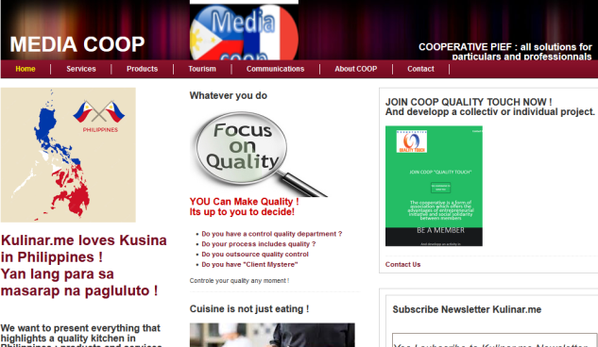
FRANCE PHILIPPINES
PHILIPPINES FRANCE
http://www.francephilippines.fr
Sites web
GROUPE
http://www.philippinesfrance.com
French Touch Maison
http://www.frenchtouchmaison.com
Agence Asie Pacifique
Agence Media
http://www.philippinesfrance.com/media.html
http://www.francephilippines.fr/consulting/index.html

Slide 22

Group PHILIPPINES FRANCE
Contact Francois Renaut
(+63) 969 196 0782
Francois.renaut@yahoo.ro
http://www.frenchtouch.ovh

Slide 23
Groupe FRANCE PHILIPPINES
Contact Didier Berger
(+33) 6 80 26 87 73
info@francephilippines.fr
http://www.francephilippines.fr

